Slide 1
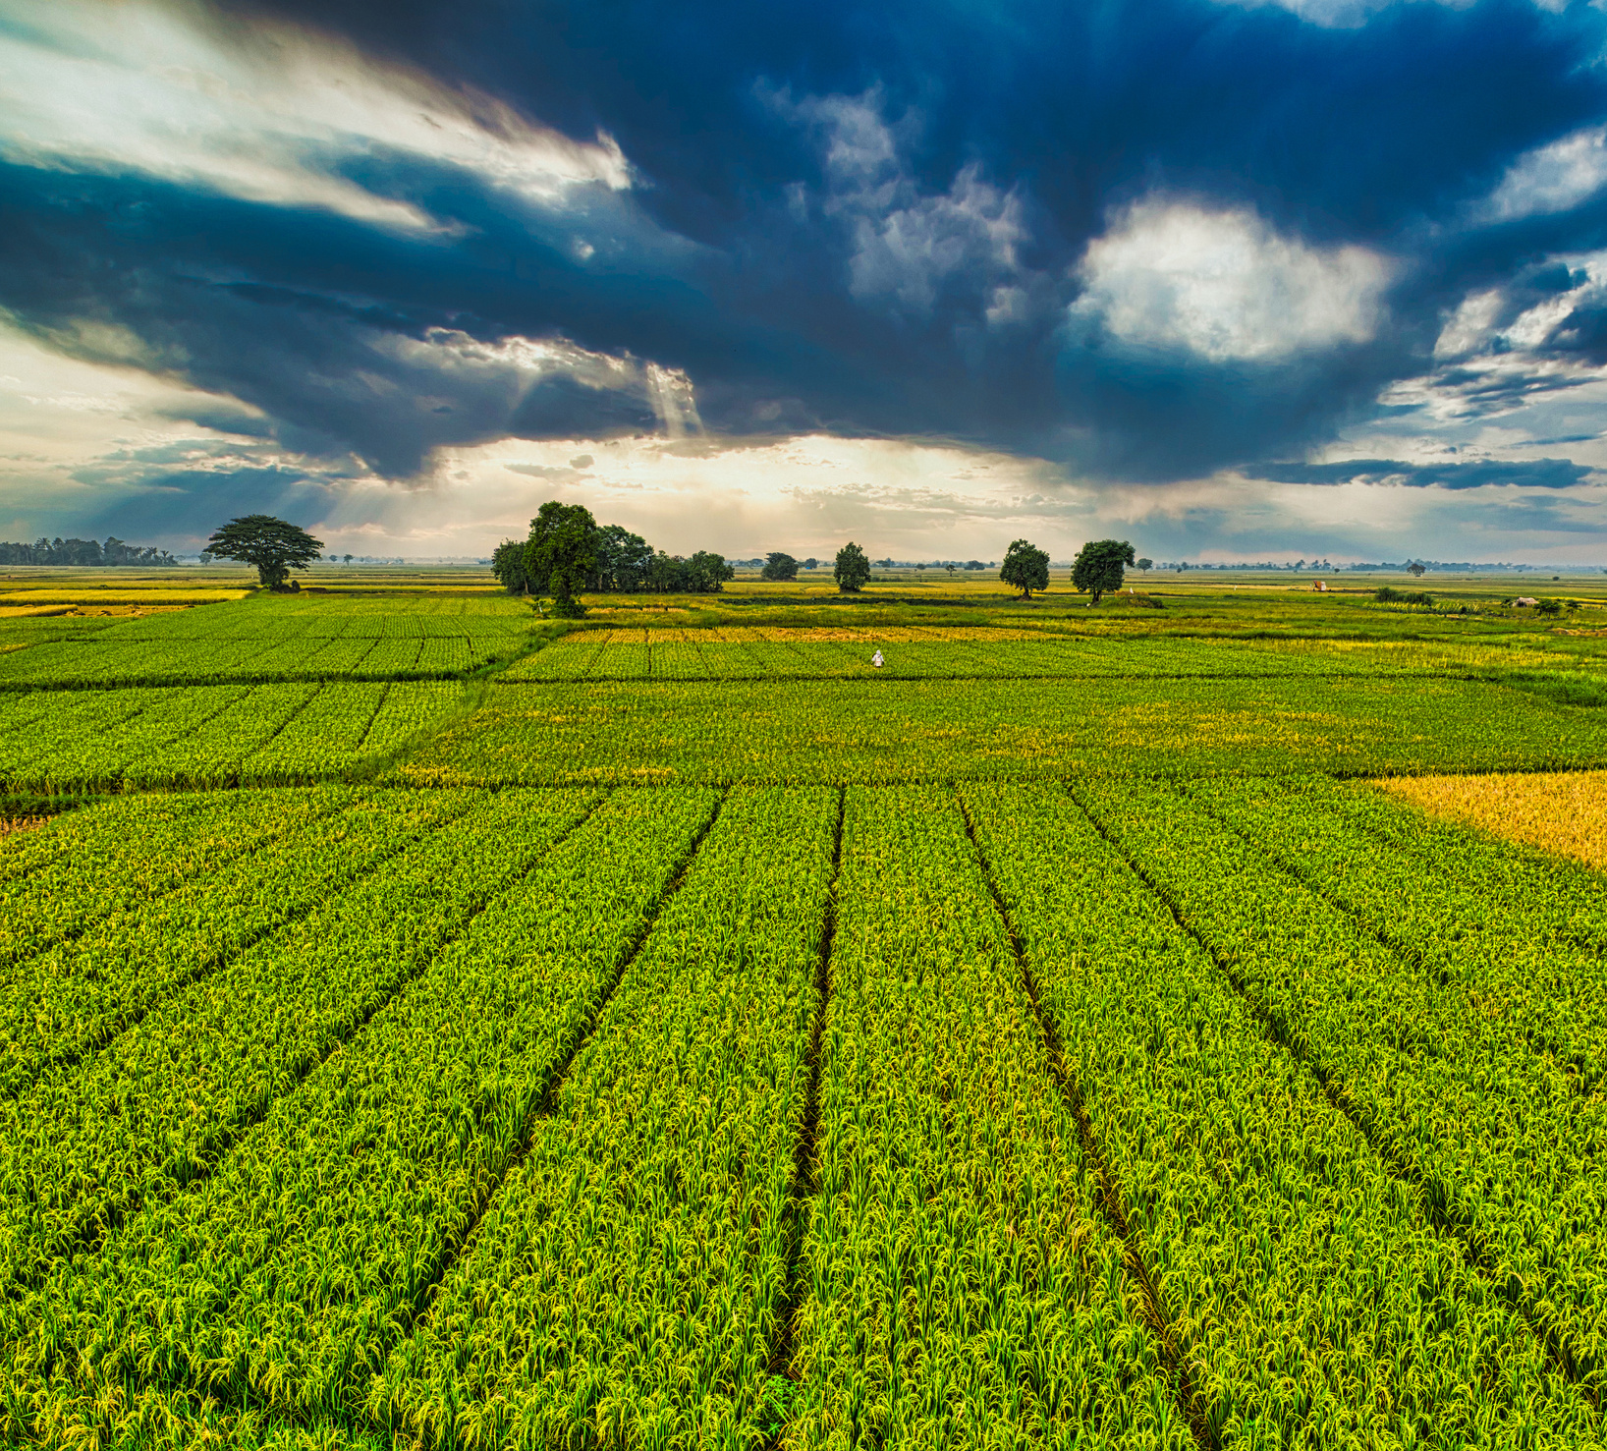





GUARDING AGRICULTURE'S
IOT REALM
Detecting Malware & Strengthening Cybersecurity
Anushka Rawat
Paper ID #G20DA0564

Slide 2

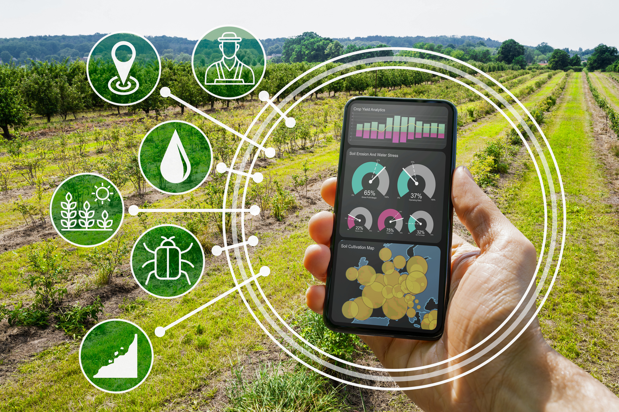

INTRODUCTION
The agriculture sector is undergoing a digital revolution through widespread IoT adoption, transforming farming practices all over the world.
IoT sensors and devices can collect real-time data on
soil conditions,
weather patterns,
livestock health, etc.,
enabling farmers to make informed decisions, reduce resource wastage, and enhance overall productivity.
Through IoT, agriculture has become smarter and more efficient, offering the potential to address global food security challenges while promoting sustainable and environmentally responsible farming practices.

Slide 3



BUT?
This shift from traditional to wireless, sensor-based systems poses cybersecurity challenges.
Precision agriculture devices are at risk of device capture attacks, threatening sensitive data.
Interconnected objects like drones and sensors communicate through machine-to-machine or cloud networks, emphasizing the need for robust authorization and trust mechanisms to safeguard vital agricultural data.
This transition necessitates vigilant cybersecurity measures.

Slide 4
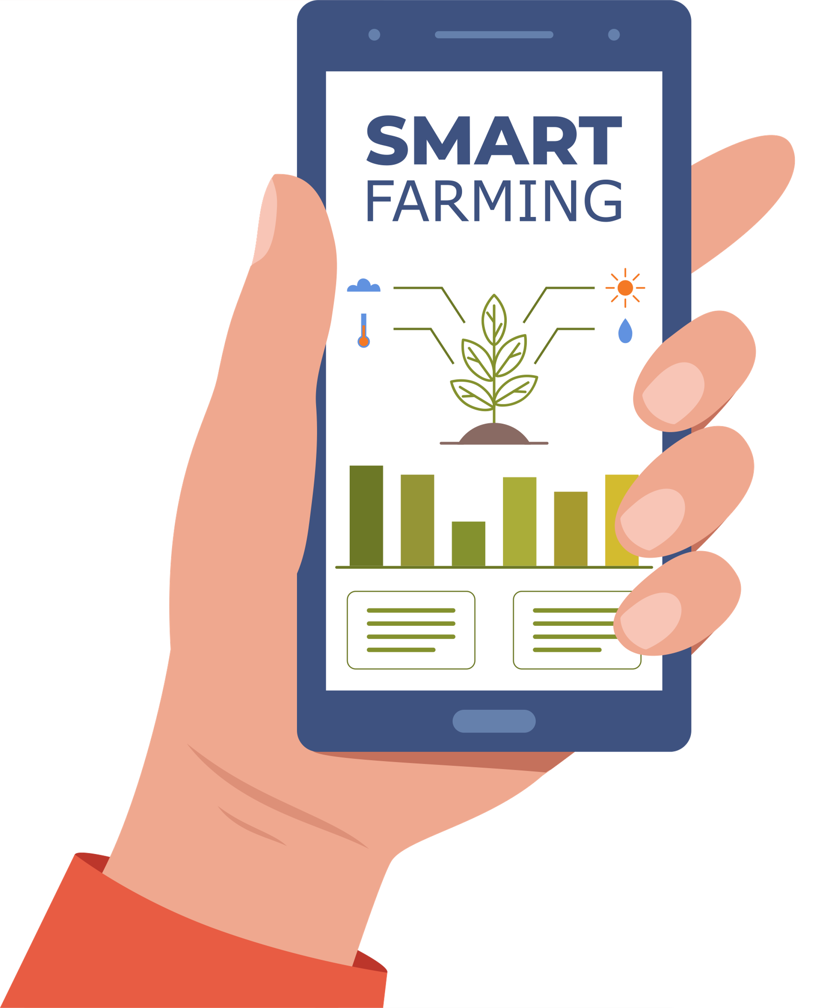





OBJECTIVE
Aim:
This research aims to address the emerging cybersecurity challenges in agriculture's digital transformation driven by IoT adoption by developing a model for IoT malware detection and classification.

Slide 5
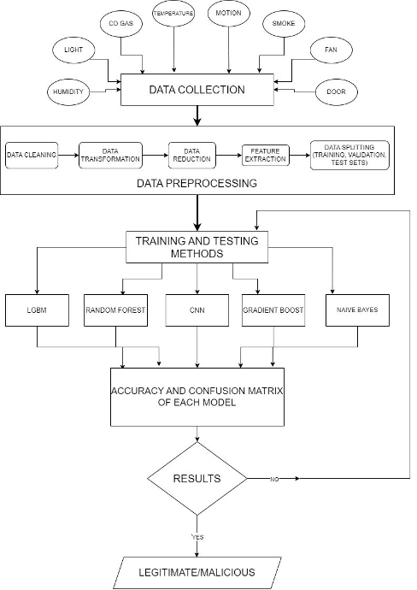

METHODOLOGY
In the proposed model, IoT malware from the MQTT dataset has been detected and classified with the help of different machine learning algorithms such as Random Forest, CNN, Gradient Boost, and Naive Bayes which are then compared on the basis of their accuracy, F1 score, and confusion matrix.

Slide 6
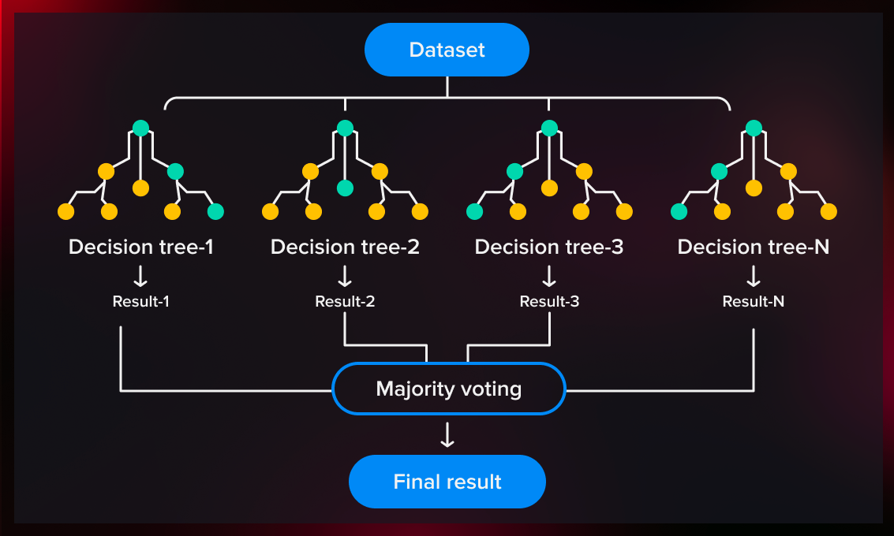
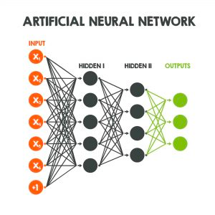
06
ALGORITHMS USED
RANDOM FOREST
CNN

Slide 7
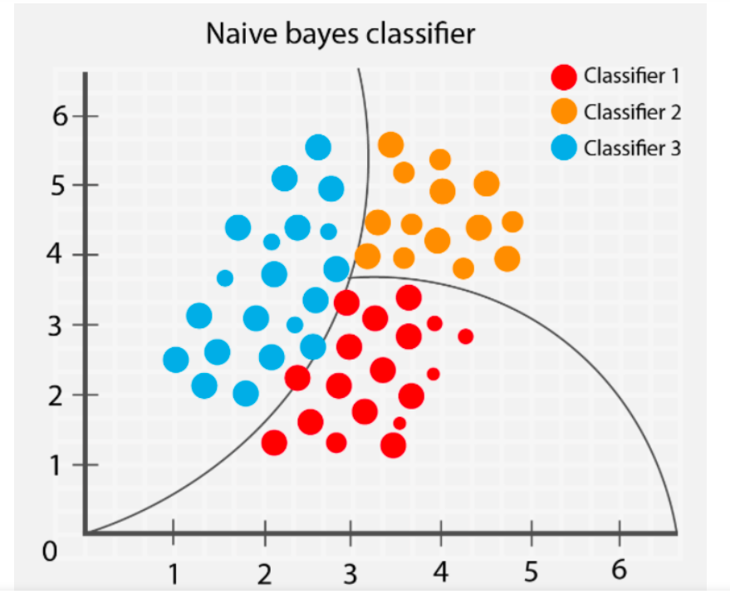
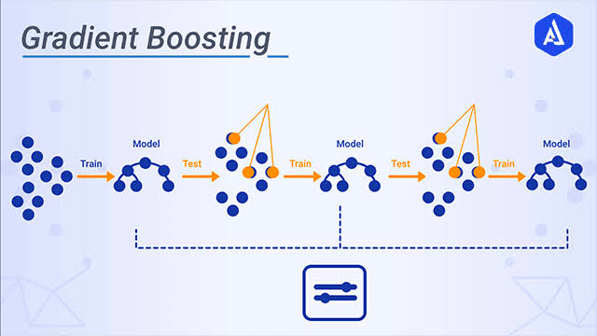
ALGORITHMS USED
GRADIENT BOOST
NAIVE BAYES

Slide 8

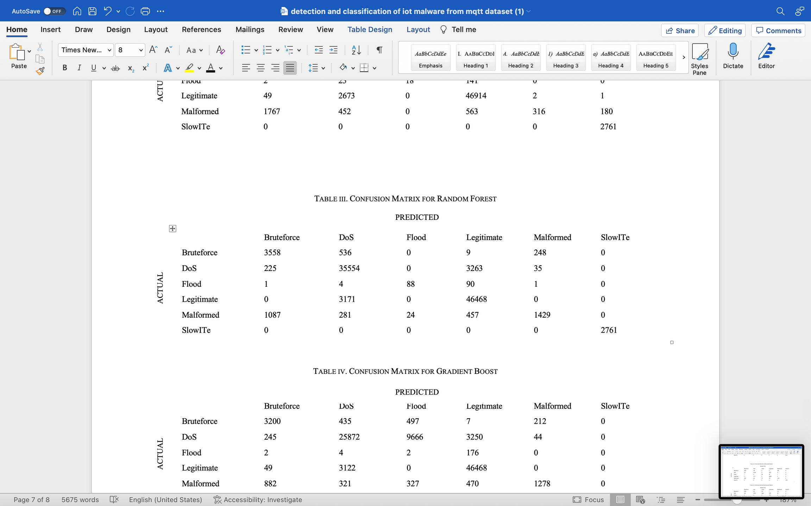
07
RESULT
Accuracy
F1 Score
100
75
50
25
Confusion Matrix
0
CNN
Random Forest
Gradient Boost
Naive Bayes

Slide 9
ACCURACY
90.5%
85.5%
80%
78.6%
RANDOM FOREST
CNN
GRADIENT BOOST
NAIVE BAYES

Slide 10
CONCLUSION
This research highlights the critical importance of addressing cybersecurity challenges as agriculture undergoes a digital transformation through IoT adoption. The study successfully developed an effective IoT malware detection and classification model, with Random Forest achieving a high accuracy of 90.5%.
As agriculture ventures into the digital era, this research serves as a foundational step in securing IoT-enabled farming systems.

Slide 11

FUTURE WORK
Future studies in digital agriculture should prioritize IoT security enhancements, threat intelligence systems, and secure communication protocols.
Future measures must encompass regulatory frameworks, security audits, collaborative threat sharing, secure supply chains, and continuous monitoring.
Most potential avenue for future research in this domain could involve the creation of a dataset comprising malware samples derived specifically from IoT devices utilized in agricultural settings.

Slide 12


THANK YOU!

